Slide 1
Non-Monotonic Sequential Text Generation

Slide 2
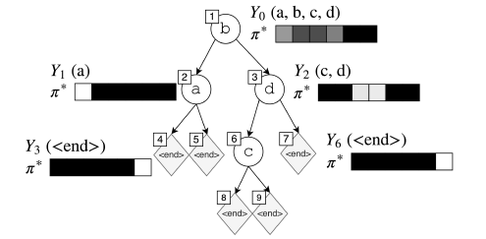
Main Idea
Generate a sequential without fixed order
Build a binary tree by choosing a word under a certain situation s via policy pi and level order

Slide 3

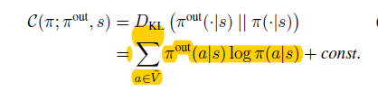
Background
pi(a|s): the policy to learn
oracle policy pi*: the policy to be mimicked
Roll-in policy pi_in: the policy to draw states
Roll-out policy pi_out: the policy to calculate cost (use pi* in practice)
V~: words and <end>
Cost function:

Slide 4
How to sample a tree?
Roll-in policies:
In analyses, it should be a stochastic mixture of pi and pi*
But experimentally, directly using pi* seems to be better because of the noise incurred early on the learning pi
When generating a tree of a certain sample sentence, use Roll-in policy to choose a word and divide the rest part of sentence into two sub-trees.

Slide 5


Oracles pi*
Uniform Oracle:
Treat all possible generation as equally p=1/n
Coaching Oracle:
Seem to just hide impossible action in Uni-Oracle and use pi
Annealed Coaching Oracle:
Beta decrease while training
Deterministic Left-to-Right Oracle:
Always select the first unused word

Slide 6

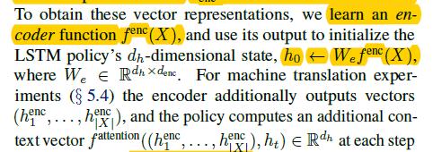
Neural Net Policy Structure
Use LSTM to deal with level-order tree
Input: sequence of nodes in partial tree by level-order, a1…at
Output: a distribution over V~, h1…ht
Conditional generation: the condition will be represented as a d-dimensional vector

Slide 7

Experiment
1.Language Modeling
2.Sentence Completion
3.Word Reordering
4.Machine Translation

Slide 8
AMR Parsing with Cache Transition Systems

Slide 9
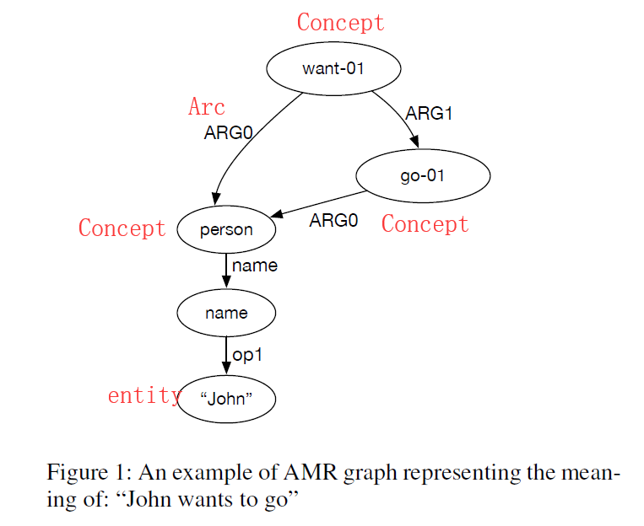
AMR Graph

Slide 10
Cache-transition-based AMR Parser
The task of AMR graph parsing is to map natural language strings to AMR semantic graphs.
Balance between efficiency and graph complexity.
First the tokens in the string are mapped to vertices (concepts) in the graph.
Then in a second phase directed, labeled arcs are made between concepts to build the target AMR graph.

Slide 11
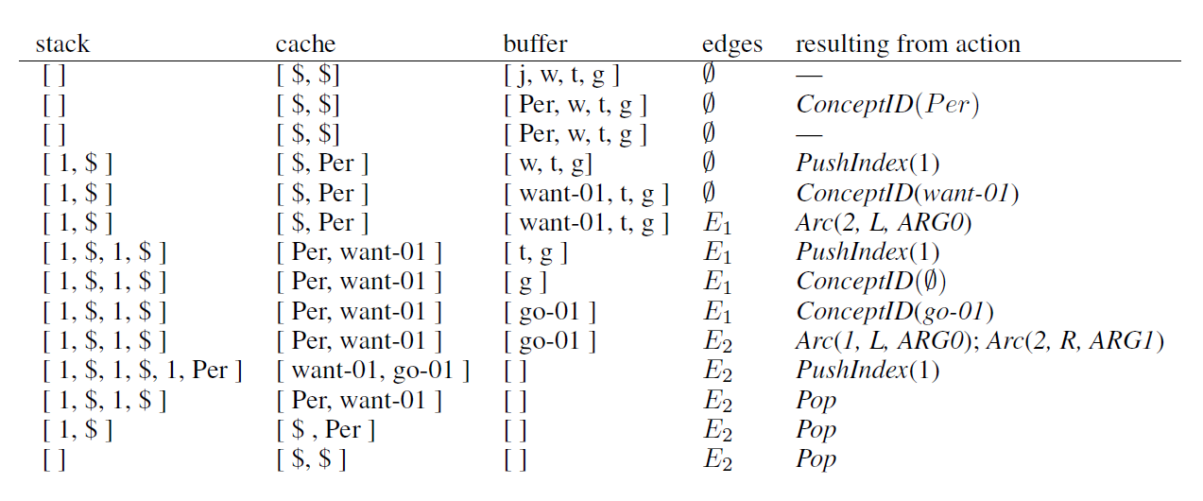
Some concepts with an example
Stack: σ，(integer, vertex)
Cache: η， vertices
Buffer: β， tokens
Configuration: C=(σ,η,β,Gp)

Slide 12

Oracle Algorithm
1. If there is no edge (vm; v) in EG such that vertex v is in S(buffer?), the oracle chooses transition Pop.
2. If the next token in the buffer is unaligned, the oracle chooses transition ConceptID() and simply shift sit out of the buffer.
3. If the next token wi in the buffer is aligned to concept ci, the oracle chooses transition ConceptID(ci). We replace the leftmost token with the candidate concept ci for further processing, which includes the next two steps.
4. For each vertex in the cache, we make a binary decision about whether there is an arc between the candidate concept ci and this vertex. If there is an arc, and if d and l are the direction and the label of the arc and the cache vertex is at position j, the oracle chooses transition Arc(j, d, l).
5. In this step, the oracle first chooses an index i in the cache and removes the vertex at this position and then places its (index, vertex) pair onto the stack. The oracle chooses transition PushIndex(i).
6. If the stack and buffer are both empty, and the cache is in the initial state, the oracle finishes with success, otherwise we proceed to the first step.

Slide 13
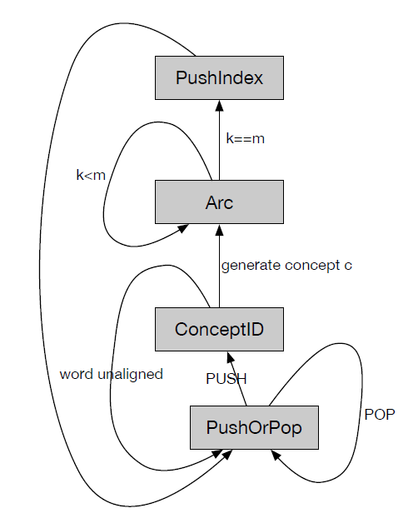
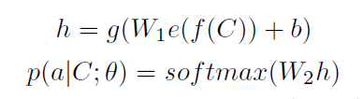
Pipeline and Training
f: feature extraction
e: embedding neural network
g: a non-linear function
W1 W2 b: trainable

Slide 14
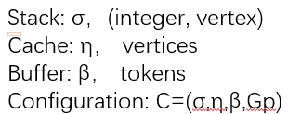
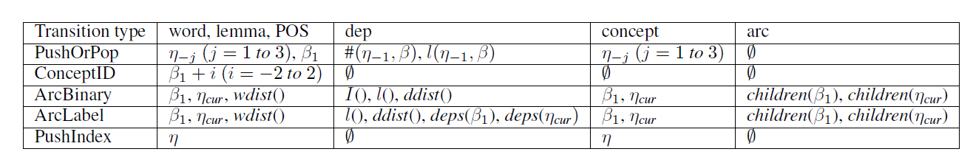
Training classifiers
0
Wdist: the distance of the two words’ embedding
Ddist: the distance of them in dependency tree
I: whether there is a dependency arc
Deps: dependencies of the word
Children: neighbor arcs

Slide 15
Categorization of Data
define some special categories such as named entities (NE), dates (DATE), verbalization (VB), numbers (NUMBER) and phrases (PHRASE).
We consider a span of tokens to be a phrase if these tokens align to the same concept more frequently than to separate concepts.(example: more than)
This categorization procedure enables the parser to capture mappings from continuous spans on the sentence side to connected subgraphs on the AMR side.

Slide 16
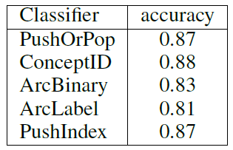
Experiments
Get NE, POS, dependencies from other datasets
Use one hidden layer with 200 tanh hidden units and a learning rate of 0.005.
Use word2vec with skip-gram and 50-dimensions
Cache with size 4 can cover 90% graphs.

